Slide 1
Writing Testable Software
An introduction to writing adaptable and testable software, and unit testing
Copyright © 2016 Anthony Fung
Disclaimer: this presentation is not associated with any of the testing and/or mocking frameworks mentioned within

Slide 2
SOLID Principles
Single responsibility
Each class should only be responsible for one thing
Keeps classes small and focused
Open/closed
Design classes to be open for extension, closed for modification
Additional requirements should not require changes in existing functioning code
Liskov substitution
A class should be substitutable for a subclass without changes in desired behaviour

Slide 3
SOLID Principles
Interface segregation
Prefer multiple smaller interfaces to single multi purpose ones
Implementing classes should not need to implement “out of place” members
Dependency inversion
Let the framework provide module dependencies
Increases ease of testability

Slide 4
Pure Functions
Easy to create test cases
Output is always the same for the same inputs
Does not modify/depend on state
Not always possible/practical

Slide 5
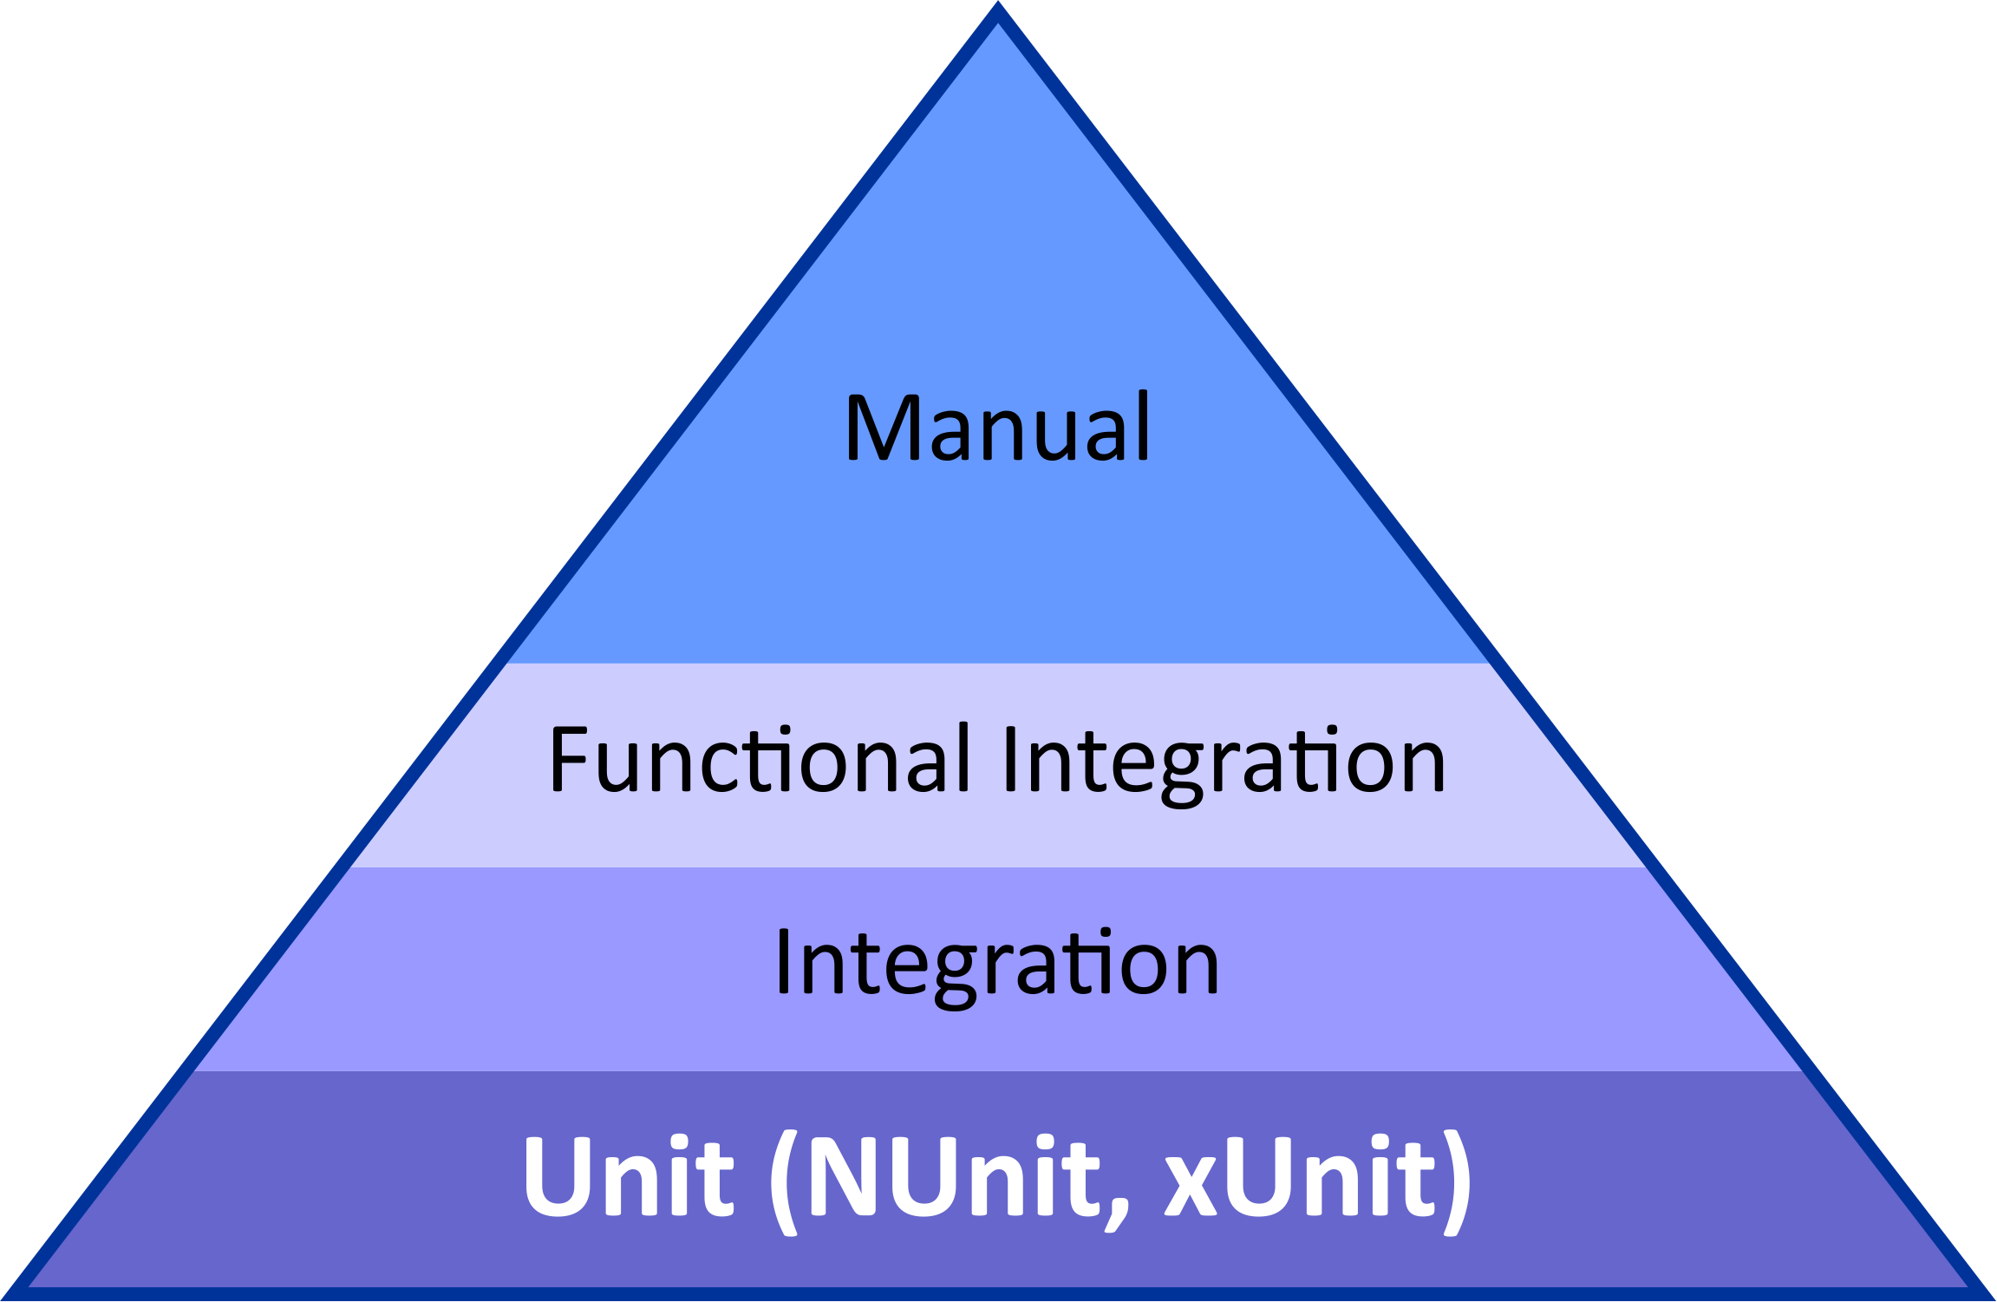
Types of Tests

Slide 6
Test Driven Development
Write test before code
Bug fixes
New features/requirements
Make code compile
Check added test fails
Write minimal code so all tests pass
Refactor
Repeat

Slide 7
Test Driven Development
“Red, Green, Refactor”
Test the method/function, not the implementation
Does not mean eliminating all private methods
Only aim to produce “ravioli” code where appropriate; not by default
Stack trace can get very deep when debugging
Difficult to follow
Easy to get lost
TDD not always appropriate
e.g. throwaway prototypes for new idea

Slide 8
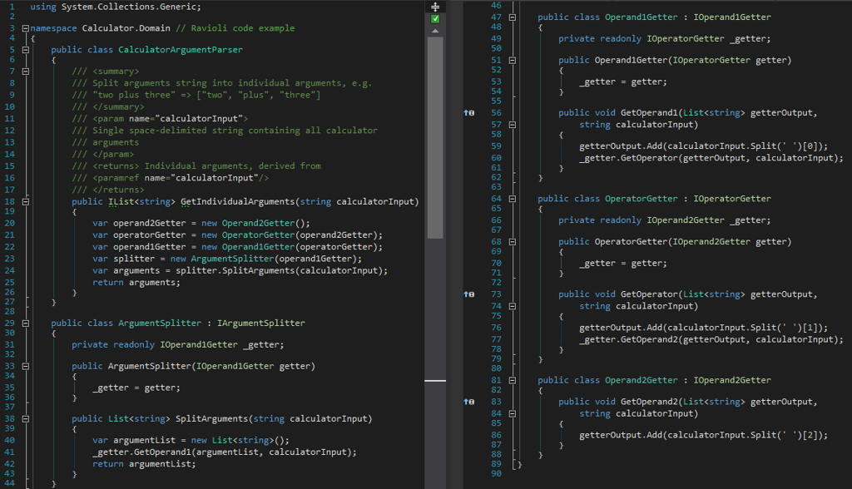

Slide 9
Test Doubles
Mock
Create using mocking frameworks, e.g. Moq, NSubstitute
Can specify return values for given method inputs
Verify that methods were called
Stub
Method calls return predefined values
Fake
Contains simplified/not-production-suitable implementation

Slide 10
Writing Unit Tests
Test structure
Arrange: create/setup objects for test
Act: run the method to be tested
Assert: verify/assert results from Act stage
Add section header comments
Helps to quickly identify what each part of the test is doing
InternalsVisibleTo attribute
Allows test assemblies access internal members
Does not create dependency to test assembly

Slide 11
Writing Unit Tests
Helpful to use 80 character line length guideline
Allows snapping code and test side-by-side without horizontal scrolling
Useful with TDD
Prefer fewer assertions per test

Slide 12
Using Fewer Assertions per Test
Each test becomes more specific
if third assertion of nine fails, it is unknown whether the other six fail from looking at unit test results
Each test is (generally) smaller, and easier to understand
More maintainable with specification changes
Easier to add/delete specific targeted tests than modify large multipurpose tests

Slide 13
Naming Unit Tests
Describe what happens under what circumstances
Many different conventions
My recommendation:
Do not prefix test name with Should
Adds no value if every test begins Should
Test names can be long: unnecessary to add six characters to every test name
Include name of method being tested
Test name should be based on the assertion(s) being made
Describe how the test subject has been setup (if appropriate)

Slide 14
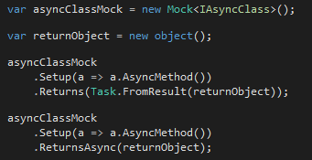

Helpful Tips: Moq
Setting up return values for async methods
Linq to Mocks

Slide 15

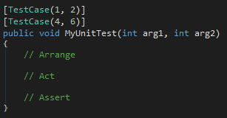
Helpful Tips: NUnit
Class (test fixture) level generics
Specific test cases

Slide 16
Example Project
https://github.com/Ant-f/WritingTestableSoftware

